Slide 1

census data analysis
USING HADOOP FRAMEWORK
BY: BINDU BHARGAVI
ID: S170020200571

Slide 2
Topics to discuss:
What is BIGDATA and its importance.
Apache Hadoop-architecture and ecosystem
MapReduce and how it works?
What is census?
Census importance and its users.

Slide 3

Some of the reasons why big data is generating:
NEW TECHNOLOGIES
NEW DEVICES
COMMUNICATION MEANS-SOCIAL NETWORKING SITES

Slide 4

FIELDS THAT COME UNDER BIGDATA:
SEARCH ENGINE DATA
BANK DATA
BLACKBOX DATA
AVIATION DATA
STOCK EXCHANGE DATA
SECURITY DATA
SOCIAL MEDIA DATA

Slide 5
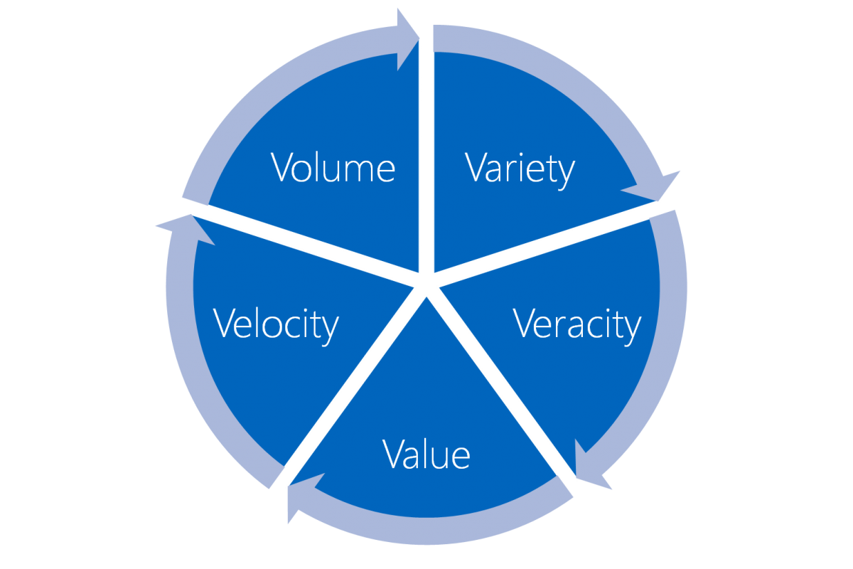
BIG DATA INCLUDES 5 Vs
TYPES OF DATA
STRUCTURED DATA
UNSTRUCTURED DATA
SEMI STRUCTURED DATA

Slide 6
IMPORTANCE OF BIG DATA:
Cost reductions and Time reduction
New product development and optimized offerings
Smart decision making.
Determining root causes of failures, issues and defects in near-real time.
Generating coupons at the point of sale, based on the customer’s buying habits.
Detecting fraudulent behaviour before it affects the organization.

Slide 7

What is Apache Hadoop?
Open source software framework designed for storage and processing of large scale data on clusters of commodity hardware
Created by Doug Cutting and Mike Carafella in 2005.
Cutting named the program after his son’s toy elephant.

Slide 8
The Hadoop Ecosystem
Hadoop Common
Contains Java Libraries and utilities used by other modules
HDFS
Hadoop Distributed File System
Hadoop YARN
Yet Another Resource Negotiator
Hadoop MapReduce
A YARN based programming model for processing large sets.

Slide 9
HDFS(Hadoop distributed file system)
HDFS is a file system written in Java based on the Google’s FS
Runs on commodity hardware.
HDFS is highly fault tolerant and designed using low-cost hardware.
HDFS holds very large amount of data and provides easier access.
Files are stored in redundant fashion to rescue the system from possible data losses in case of failure.

Slide 10

HDFS ARCHITECTURE

Slide 11
MapReduce Overview
A method for distributing computation across multiple nodes
Each node processes the data that is stored at that node
Consists of two main phases
1.Map
2.Reduce

Slide 12
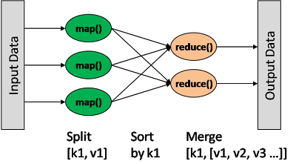
HOW MAPREDUCE WORKS?

Slide 13
The Mapper
SORT AND SHUFFLE
The REDUCER
Reads data as key/value pairs
Outputs zero or more key/value pairs.
Good place to filter unwanted data.
Output from the mapper is sorted by key
All values with the same key are guaranteed to go to the same machine
The Reducer code reads the outputs generated by the different mappers as pairs and emits key value pairs.
The reducer outputs zero or more final key/value pair.

Slide 14
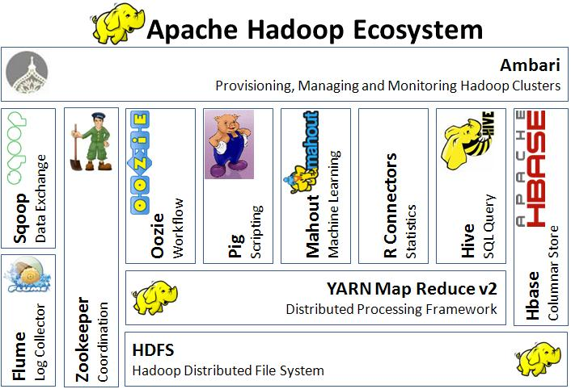
HADOOP ECOSYSTEM:

Slide 15
WHAT IS CENSUS:
Census is the total process of collecting, compiling, analysing demographic, economic and social data pertaining, at a specific time, of all persons in a country.
The census provides snapshot of the country's population and housing at a given point of time.

Slide 16
IMPORTANCE OF CENSUS:
PLANNING
DEVELOPMENT
IMPROVEMENT IN QUALITY OF LIFE OF RESIDENTS
RESEARCH
TO PROVIDE BETTER SERVICE
TO SOLVE EXISTING PROBLEMS

Slide 17
WHO USES CENSUS DATA:
GOVT AND LOCAL AUTHORITIES.
RESEARCH BODIES.
PRIVATE AND PUBLIC COMPANIES.
JOURNALISTS.
STUDENTS AND PUPILS etc.

Slide 18
Project Prerequisites:
Given census data consists of 2 files sample.dat, agegroup.dat
The sample.dat is in JSON format and hence needs to be converted in CSV format.
For that we use HIVE.
We have a hive built-in function get_json_object to convert JSON data to CSV format.

Slide 19
STEPS FOR CONVERSION:
Step 1: Create Table in hive to read entire record as one json string.
hive (census)> create table census_demo(json string) stored as textfile;
Step 2: Create Table to convert and store json string into different fields which will create a file on Hadoop filesystem in csv format. get_json_object is hive built-in function.
hive (census)> insert overwrite table censusdata select get_json_object(json,"$.Age"),get_json_object(json,"$.Education"),get_json_object(json,"$.MaritalStatus"),get_json_object(json,"$.Gender"),get_json_object(json,"$.TaxFilerStatus"),get_json_object(json,"$.Income"),get_json_object(json,"$.Parents"),get_json_object(json,"$.CountryOfBirth"),get_json_object(json,"$.Citizenship"),get_json_object(json,"$.WeeksWorked") from census_demo;

Slide 20
QUERIES:
SOCIAL ANALYSIS:
number of people who are born in US.
ratio of male population to female population.
total no of widowed females working.
ratio of married to divorced.
average age of divorced people.
total no of senior citizens(age>60) and are citizens of US.
total no of children(age<=17) whose parents are not in universe(orphans).
FINANCIAL ANALYSIS:
people who are working but not filing tax.
average income of persons whose age>25 and are not citizens of US.

Slide 21
MALE TO FEMALE RATIO:

Slide 23
CONCLUSION:
The results of use cases can be used to take certain measures for the welfare of the society.
In social analysis, we found total number of widowed candidates ,number of senior citizens, etc. so some plans or schemes can be provided to them.
We found male to female ratio which is used to determine number of females per male.
In financial analysis, we found the number of people who are working but not filing tax. So, necessary steps can be taken against them.

Slide 24
THANK YOU

